Slide 1

For PC
Made Available on Steam
Rating: E10+

Slide 2

2D survival puzzle game.
Silent protagonist.
Pitch black maze environment.
Avoid all hazards and monsters.
Collect all Bell Flowers and escape.

Slide 3





Whale
Is cured.
Can use echolocation.
Wolf
Double player’s speed.
3 rock throws to kill.
Zombie
Half player’s speed.
Easy to get away from.
Bear
Same as player’s speed.
Will tire after 30 seconds.
Frog
1.5x player’s speed.
1 rock throw to kill.

Slide 4

Ghost
Stuns player for 10 seconds when touched.
Disappears after.
Can not be killed.

Slide 5

Dreed
Instant brutal death.
Sends player back 5 levels.
Can only be woken by stomps.

Slide 6
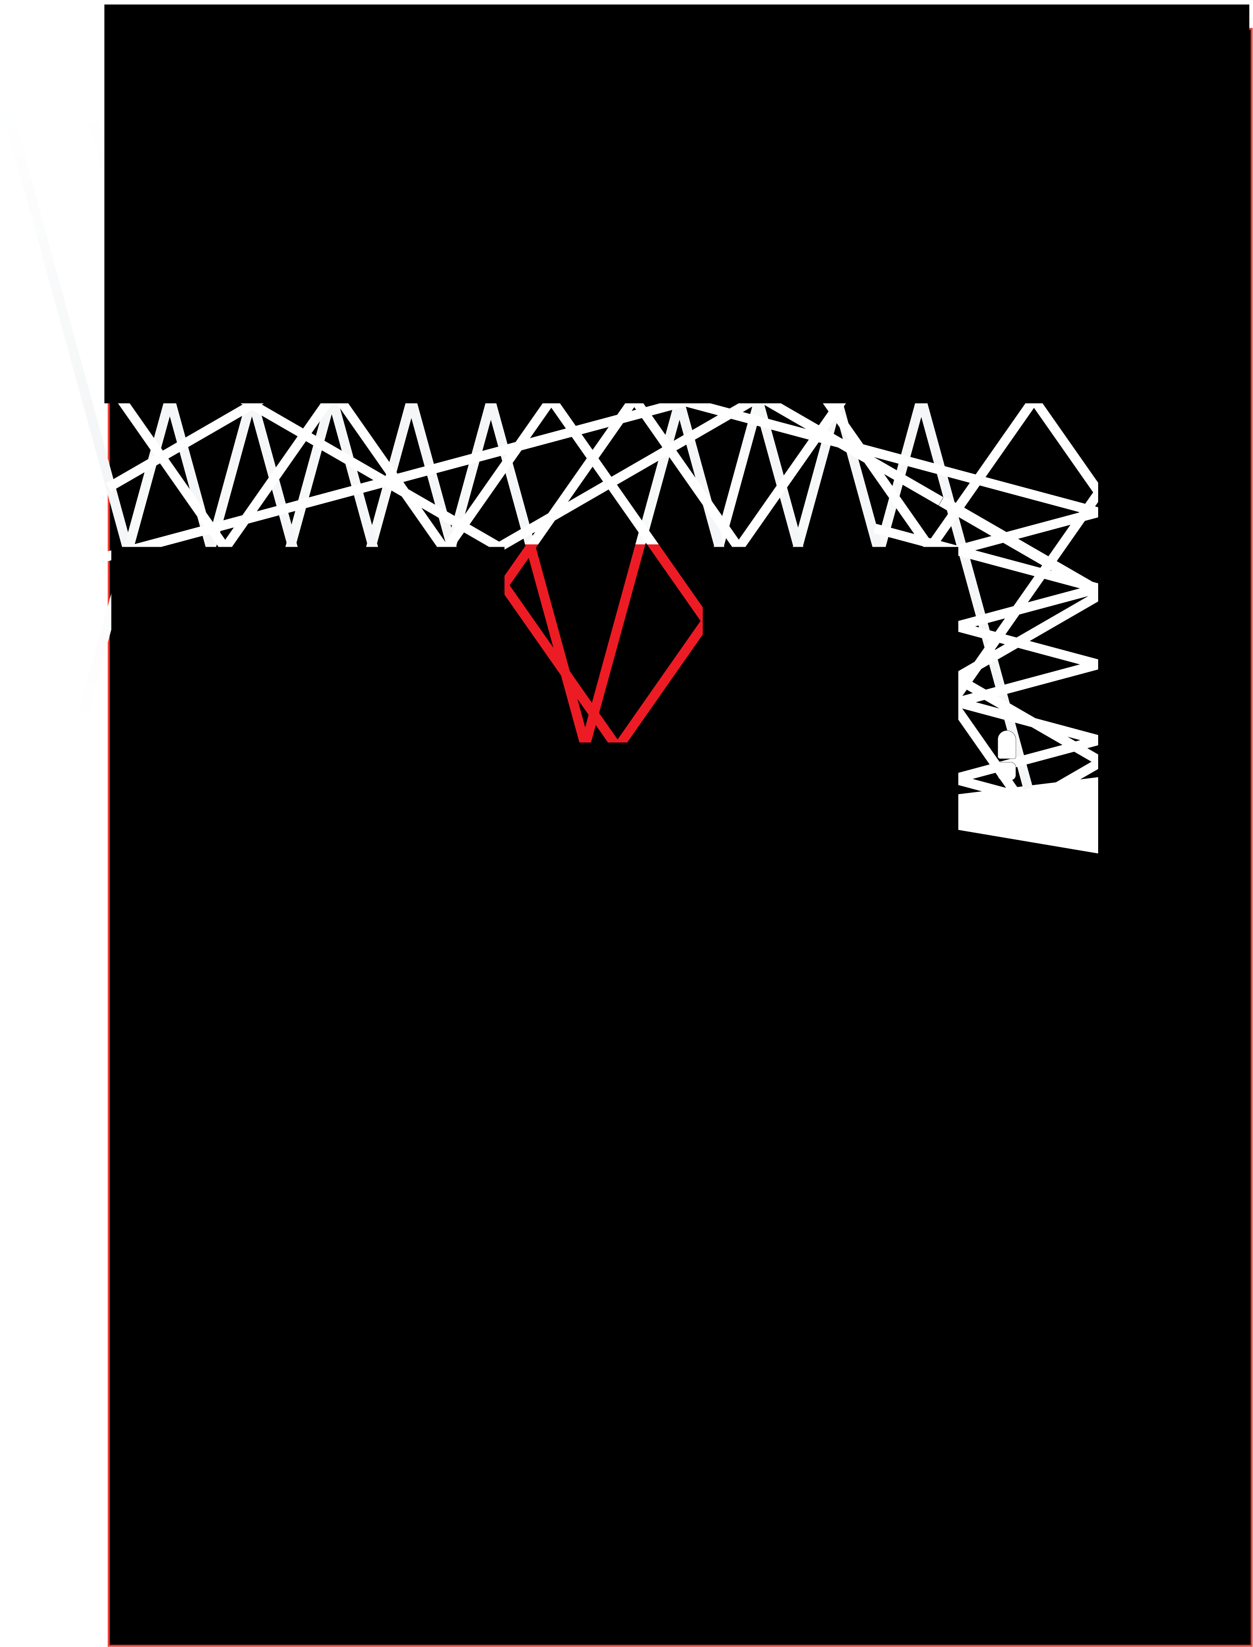



Slide 7

Regular Ground
Regular speed.
Sound lasts for each footstep.
3 times foot size for footsteps.
10 times foot size for stomp.

Slide 8

Water
0.75x speed.
Sound lasts for 10 seconds after each footstep.
Spreads out throughout all of the water area.
Multiple sound waves for stomp.

Slide 9

Ice
2x speed.
Sound lasts every other footstep.
4 times foot size for footsteps.
Will break if stomped and player dies.

Slide 10

Mud
0.5x speed.
Sound lasts each footstep.
1 times foot size for footsteps.
Will clear area 4 times foot size if stomped.

Slide 11
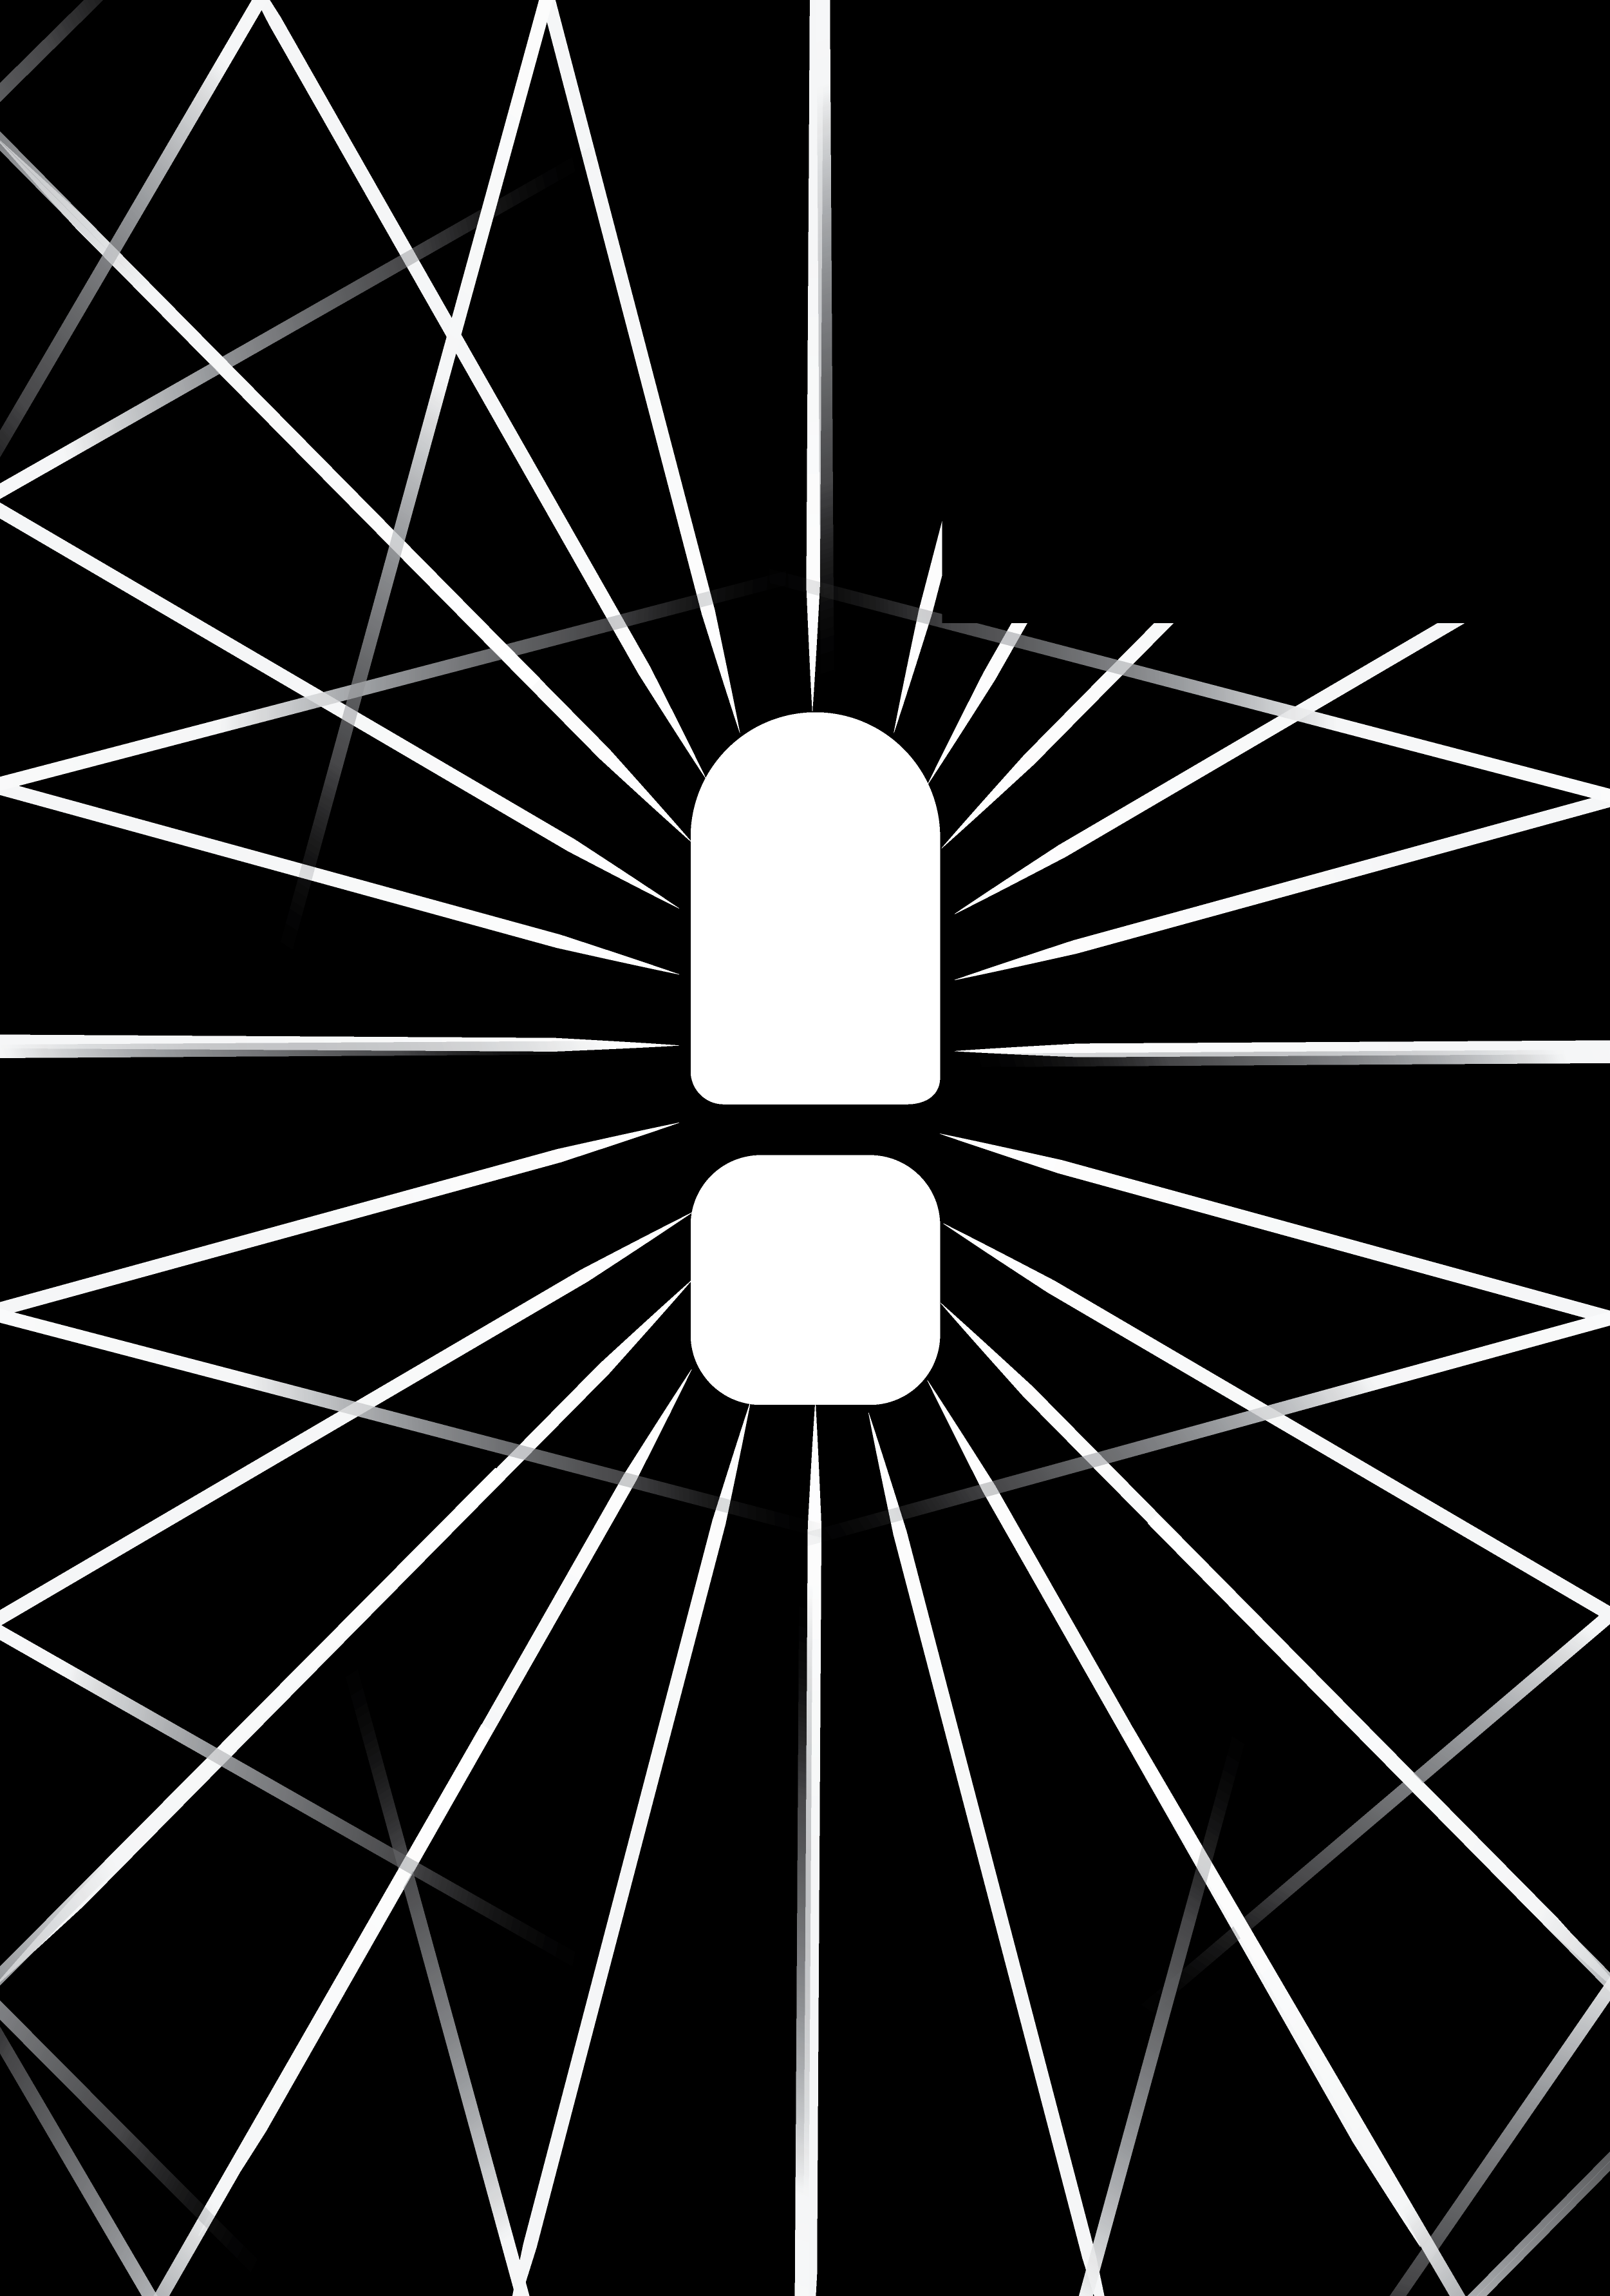

Slide 14

Collectibles
Found through exploration.
Are invisible.
Collected by walking on top of them.

Slide 15
Cutscenes
2 major cutscenes.
Plays at start of game showing the epidemic.
Plays at end of game showing the village thanking Whale.
2 minor cutscenes.
Every time Whale enters and exits the cave.

Slide 16


